Slide 1

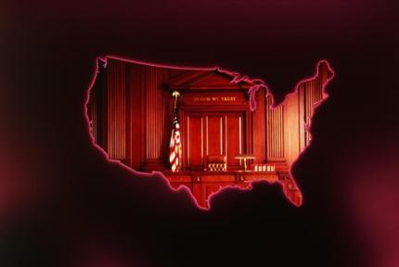
Courtroom Roles and Responsibilities

Slide 2

introduction
The courtroom is made up of various roles that perform specific functions.
The roles are vital in having a criminal justice system that is fair and just.
We will be looking at what these roles are and what function they serve in the courtroom.

Slide 3
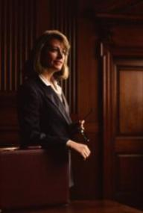
prosecutor responsibilities
Representative of the state
Present the evidence to the jury
Usually, at least two prosecutors are assigned to the courtroom for each trial.

Slide 4

prosecutor responsibilities
Opens the trial with an opening statement
Intended to “wet the appetite” of the jury regarding the topic of the trial and
Why the defendant is guilty
Presents their case to the jury first
Notes:
ross

Slide 5

prosecutor responsibilities
Gives a closing statement to the jury at the end of the trial
Summarizes why the defendant is guilty
Given after the defense attorney’s closing statement

Slide 6
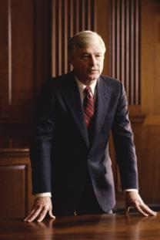
defense attorney responsibilities
Representative of the defendant
May be employed by the defendant or
May be appointed by the state to represent the defendant

Slide 7
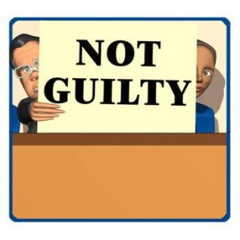
defense attorney responsibilities
Gives an opening statement after the prosecutor
Intended to inform the jury that their client is innocent
As they will be convinced of when the trial is over

Slide 8
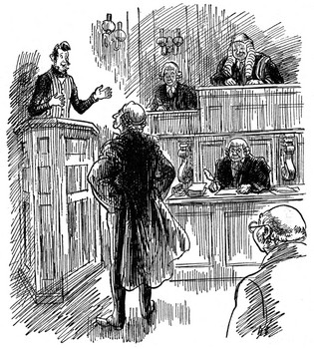
defense attorney responsibilities
Presents his or her case to the jury after the prosecution has presented its case

Slide 9
defense attorney responsibilities
Gives a closing statement when done with the case
Should summarize the case for the jury and
Emphasize why the defendant is innocent

Slide 10

CIVIL ATTORNEY FOR THE PLAINTIFF
I represent a plaintiff in a civil case as their lawyer.
I study the law, interview witnesses, and try to build a case showing that the civil defendant violated my client’s rights.
I present evidence to show a judge or jury that the defendant violated my client’s rights and owes something to my client.

Slide 11
CIVIL ATTORNEY FOR THE DEFENSE
I represent a defendant in a civil case as their lawyer.
I study the law, interview witnesses, and try to build a case showing that the my client did not violate anyone’s rights or break civil laws.
I present evidence to show a judge or jury that my client did not violate the plaintiff’s rights and does not owe the plaintiff anything.

Slide 12

judge responsibilities
The judge
Is referee in the courtroom
Has the final say on everything that happens in the courtroom (except the jury’s verdict)
If the defendant has waived his or her right to a jury trial, then the judge also decides the guilt or innocence of the defendant

Slide 13
judge responsibilities
The judge makes two types of rulings on objections:
Sustained– the witness is NOT allowed to answer the question that has been asked of them
Overruled– the witness IS allowed to answer the question that has been asked of them

Slide 14
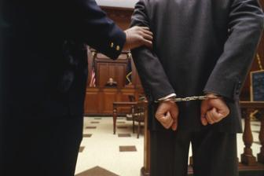
criminal defendant responsibilities
The defendant is
The person accused of committing the crimes and
Is protected by the 5th amendment from testifying against his or her self in court
If the defendant chooses to testify,
They will be questioned by the prosecution as well as the defense.

Slide 15
Plaintiff responsibilities
The plaintiff files a lawsuit against someone that thinks has violated his, her, or their rights.
The plaintiff works with their lawyers to gather evidence and develop a case in civil court.
During a trial, the plaintiff sits with their lawyer and hopes that the judge or jury will decide their rights were violated and order the other side to pay them back. They may or may not testify.

Slide 16
Civil defendant responsibilities
The civil defendant has been sued by someone who thinks they have violated their rights.
The defendant works with their lawyers to gather evidence and defend against the plaintiff’s case.
During a trial, the defendant sits with their lawyer and hopes that the judge or jury will decide that they did not violate anyone’s rights and will not have to pay anything in compensation.
They will probably testify.

Slide 17
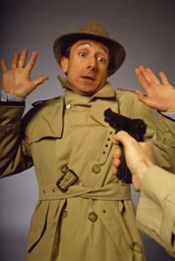
victim responsibilities
The victim is
The person who the crime was committed against
Usually called to testify during the course of the trial

Slide 18
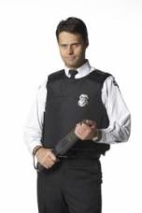
bailiff responsibilities
The bailiff
Is a certified peace officer that maintains order in the court
Administers the oath to anyone who takes the stand
Takes things to and from the judge
Does anything else that the judge needs him or her to do

Slide 19

court reporter responsibilities
The court reporter
Is an employee of the court who records everything that is said in the trial
Goes to a school where they learn how to take notes using a style called shorthand
These notes are official documents that may be used as reference in future court proceedings.

Slide 20
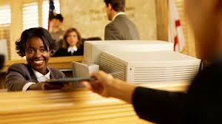
court clerk responsibilities
Takes notes in the courtroom.
Marks all the evidence the lawyers want to use during the trial.
Gives each piece of evidence a number to create a record of everything.

Slide 21
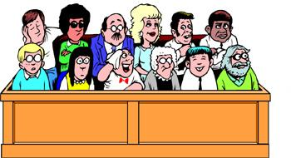
jury responsibilities
The jury
Consists of 6 to 12 U.S. citizens
Selected before the trial by the prosecutor and defense attorney
The judge has the final say on who can serve on the jury
Observes the trial then decides on the guilt or innocence of the defendant

Slide 22
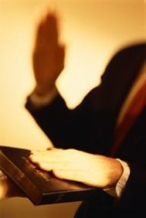
witness
A witness is anyone who is called to testify at a trial
Before the trial, witnesses give statements to the police and to lawyers that can be used as evidence.

